Slide 1
PROJECT TITLE:SPARK (Strategic Productivity Analytics and Reporting Kit)
PIP104 PROFESSIONAL PRACTICE-II
VIVA-VOCE
Batch Number:G119
Roll Number | Student Name
20201CSE0686 | ANJALI KUMARI
20201CSE0713 | AISHWARYA
20201CSE0714 | MARK AVINASH
Under the Supervision of,
Dr. Hasan Hussain S
School of Computer Science Engineering
Presidency University

Slide 2
Introduction
In today's fast-paced digital landscape, optimizing time and productivity are paramount for organizations striving to maintain a competitive edge. The Time and Productivity Analysis Web Development Project is an innovative initiative aimed at harnessing the power of technology to enhance efficiency, streamline processes, and empower businesses to make data-driven decisions.
This project centers around the creation of a dynamic web application that will serve as a comprehensive tool for organizations to measure, analyze, and improve their time management and productivity. It will not only provide real-time insights into how time is allocated across various tasks but also offer valuable performance metrics to help teams and individuals achieve their goals more effectively.
With the ever-increasing demands on businesses and the challenges posed by remote work, understanding and optimizing time usage has become a critical factor in achieving success. This web development project is designed to address these challenges and provide a user-friendly platform for organizations to unlock their full potential.
Throughout this project, we will explore the intricacies of web development, data analysis, and user experience design to deliver a solution that empowers businesses to make informed decisions, maximize productivity, and thrive in a rapidly evolving digital landscape. Join us on this journey as we embark on a mission to revolutionize the way organizations perceive and manage time, ultimately driving success and innovation.

Slide 3
Introduction
In the dynamic landscape of modern organizations, efficient resource utilization is pivotal for success. With an increasing reliance on technology and diverse tasks, understanding how time is allocated across various activities becomes essential for optimizing productivity. The chosen problem statement focuses on the development of a comprehensive tool designed to capture, calculate, and analyze the time spent by resources on specific activities, such as documentation, coding, SQL, and internet usage. This tool aims to address a critical need in organizational management: the ability to discern where resources are investing their time and, consequently, where the organization may be losing valuable productivity.
As businesses continue to evolve, the complexity of tasks assigned to resources has grown exponentially. Traditional time-tracking methods often fall short in providing a nuanced understanding of how time is distributed among diverse activities crucial to an organization's operations. The proposed tool recognizes the intricacies of contemporary work environments, acknowledging that resource time is not uniformly spent across all tasks.
In this context, the problem statement explores the broader domain of time and resource management, emphasizing the need for tools that can adapt to the diverse nature of tasks in contemporary workplaces. By delving into the intricacies of resource time allocation, organizations can make informed decisions to optimize their operations, improve productivity, and ensure the effective utilization of their valuable human capital. The subsequent sections of this research will delve into the development and implementation of such a tool, aiming to contribute to the ongoing discourse on resource management in modern organizational contexts.

Slide 4
Literature Review
1 LITERATURE SURVEY
Manual Time Tracking:
Advantages: Simple and low-cost. Individuals manually record their activities.
Limitations: Prone to inaccuracies due to human error. Tedious for users, leading to potential under reporting or incomplete data.
Time Tracking Software:
Advantages: Automates the process, reducing human error. Provides real-time tracking and reporting.
Limitations: Some tools lack granularity, offering only broad categorizations. Users may find it intrusive or may forget to log hours accurately.
Project Management Tools with Time Tracking:
Advantages: Integrates time tracking with project management, offering a holistic view. Can generate reports based on tasks and projects.
Limitations: Limited in capturing non-project-related activities. Users may not diligently update task statuses, leading to incomplete data.
Biometric Time and Attendance Systems:
Advantages: Ensures attendance and tracks time automatically.
Limitations: Primarily focuses on presence rather than detailed task-specific time tracking. Does not capture nuances of different activities.
Workplace Analytics Platforms:
Advantages: Offers advanced analytics on employee behavior and work patterns.
Limitations: May require significant integration efforts. Often emphasizes collaboration patterns over individual task-specific time tracking.
Time Management Apps:
Advantages: Encourages users to allocate time deliberately to tasks.
Limitations: Relies heavily on user discipline. May not capture passive activities or distractions.
Gamified Productivity Apps:
Advantages: Uses gamification to encourage focused work.
Limitations: Primarily focused on motivation rather than precise time tracking. Users may prioritize the game element over accurate reporting.
Blockchain-Based Time Tracking:
Advantages: Provides a tamper-resistant and transparent ledger for time records.
Limitations: Complex implementation, limited adoption. May not address the user-friendliness needed for widespread organizational use.

Slide 5
Literature Review
2 BASED ON RESEARCH PAPERS:
"Productivity and Quality Management in the Software Development Process" (2006)
Advantages:
Provides insights into the relationship between productivity and quality in software development.
Offers a holistic view of management practices that impact both productivity and quality.
Limitations:
Focuses on software development without specific attention to time tracking.
"Time-Tracking Tools for Increasing Productivity in Software Development" (2013)
Advantages:
Directly addresses the use of time-tracking tools to enhance productivity in software development.
Presents real-world cases where time tracking positively influenced outcomes.
Limitations:
May lack a broader perspective on time management beyond software development.
"Time Management and Productivity Tools for Knowledge Workers" (2007) Advantages:
Explores tools applicable to knowledge workers, potentially relevant to diverse tasks.
Highlights the importance of time management for knowledge-intensive roles.
Limitations:
May not delve deeply into industry-specific challenges, such as software development.

Slide 6
Literature Review
"Time Management and Productivity Tools for Knowledge Workers" (2007)
Advantages:
Explores tools applicable to knowledge workers, potentially relevant to diverse tasks.
Highlights the importance of time management for knowledge-intensive roles.
Limitations:
May not delve deeply into industry-specific challenges, such as software development.
"A Review of Time Management Literature" (2013)
Advantages:
Provides a comprehensive overview of time management literature across various domains.
Offers a theoretical foundation for understanding time management practices.
Limitations:
Generalized approach; lacks specificity to software development or productivity in a corporate setting.
"A Study of Web Usage for Improving Web Productivity" (2009)
Advantages:
Addresses web usage and productivity, potentially relevant for understanding internet-related activities.
Offers insights into optimizing web-based tasks.
Limitations:
May not provide a comprehensive analysis of overall time allocation.

Slide 7
Literature Review
"Analysis of Time Management and Productivity in Agile Software Development" (2009)
Advantages:
Focuses on time management and productivity within the context of Agile software development.
Offers insights into the unique challenges and opportunities in Agile environments.
Limitations:
Specific to Agile; may not generalize well to other development methodologies.
"Web-Based Tools and Applications to Enhance Research Productivity" (2011)
Advantages:
Discusses web-based tools applicable to enhancing productivity in a research context.
Offers insights into leveraging technology for improved outcomes.
Limitations:
Primarily tailored to research, potentially lacking relevance for broader organizational productivity.

Slide 8
Research Gaps Identified
The existing body of literature on time and productivity analysis has predominantly focused on macro-level organizational structures, technological interventions, and individual-level time management strategies.
However, a noticeable gap exists in the exploration of the nuanced interplay between socio-cultural factors and their impact on time utilization and productivity outcomes in diverse workplace settings.
While numerous studies acknowledge the importance of cultural context in shaping work behaviors, there is a dearth of comprehensive research that systematically investigates how cultural nuances, such as communication styles, hierarchical structures, and societal expectations, influence time management practices and subsequently affect productivity at both individual and organizational levels.
Furthermore, existing studies often lack a holistic understanding of the dynamic relationship between personal well-being, mental health, and productivity.

Slide 9
Research Gaps Identified
Limited attention has been given to examining the role of employee well-being interventions, stress management programs, and work-life balance initiatives in optimizing time utilization and enhancing overall productivity.
A comprehensive examination of these factors is essential to provide a more nuanced understanding of the complex web of influences on individual and collective productivity, particularly in the context of evolving workplace dynamics and the increasing prevalence of remote and flexible work arrangements.
Therefore, this literature gap underscores the need for future research endeavors to delve into the socio-cultural dimensions of time and productivity, exploring the intricate connections between cultural variables, well-being initiatives, and effective time management strategies.
Addressing this gap will contribute to a more comprehensive understanding of the multifaceted nature of productivity dynamics in contemporary work environments, facilitating the development of targeted interventions and policies that promote optimal time utilization and sustainable productivity outcomes.

Slide 10
Proposed Methodology
Hardware requirement:-
Hardware:
Local Machine:
Utilize a personal computer or workstation as the local development environment.
Ensure sufficient processing power, memory, and storage for smooth development and testing.
Software requirement specification:-
WAMPP v3.3.0:
Set up WAMPP as the local web server to provide a pre-configured environment with Apache as the web server, MySQL as the database server, and PHP for server-side scripting.
Configure WAMPP to support PHP language execution and MySQL database operations.
Programming Languages:
Utilize PHP as the primary server-side scripting language for building dynamic web pages.
Employ HTML for structuring web content.
Apply CSS for styling and layout enhancements.
Incorporate JavaScript for client-side scripting.

Slide 11
Methodology
Front-End Frameworks:
Implement Bootstrap for responsive and mobile-first design.
Utilize jQuery for simplified and efficient JavaScript code.
Integrate Ajax for asynchronous communication with the server, enhancing user experience.
AdminLTE Template:
Utilize the AdminLTE template for the administration dashboard.
Leverage the template's pre-built components and styles for a professional and user-friendly admin interface.
Database Management:
Use MySQL as the relational database management system.
Develop the database schema to store time tracking data, user information, and other relevant details.
Continuous Integration:
Explore continuous integration tools (e.g., Jenkins) for automated testing and deployment processes.
Implement CI/CD pipelines to streamline development workflows.

Slide 12
Methodology
Security Measures:
Implement secure coding practices to prevent common vulnerabilities (e.g., SQL injection, cross-site scripting).
Utilize password hashing for user authentication.
Ensure proper validation and sanitation of user inputs.
Version Control:
Use Git for version control, allowing for effective collaboration and codebase management.
Host the project on platforms like GitHub or GitLab for version tracking and collaboration.
Testing:
Employ PHP Unit for unit testing PHP code.
Utilize browser developer tools and testing frameworks for front-end testing.
Perform end-to-end testing to ensure the proper functioning of the entire application.
Documentation:
Maintain comprehensive documentation for code, database schema, and project structure.
Include installation guides and usage instructions for developers and administrators

Slide 13
Objectives
1. Time Tracking: Users should be able to easily record and categorize their activities, including work tasks, personal projects, and leisure time.
2. Productivity Analysis: The system should generate insightful reports and visualizations to help users understand their time allocation, identify time-wasting activities, and improve productivity.
3. Goal Setting: Users should be able to set goals and milestones, track their progress, and receive notifications to stay on track.
4. Integration: The program should seamlessly integrate with calendars, to-do lists, and other productivity tools for a comprehensive time management experience.
5. User-Friendly Interface: The web application should have an intuitive and user-friendly interface that makes it accessible to a wide range of users.

Slide 14
Objectives
6. Privacy and Security: Ensuring the confidentiality of user data and implementing robust security measures to protect user information is paramount.
7.Scalability: The system should be designed with scalability in mind, allowing for future updates and enhancements.
8. User Engagement: Encourage user engagement through gamification, reminders, and personalized recommendations.
9. Feedback Mechanism: Implement a feedback system to gather user input and continuously improve the application.
10. Performance Optimization: Ensure the web application is responsive and performs efficiently, even with a large user base.

Slide 15
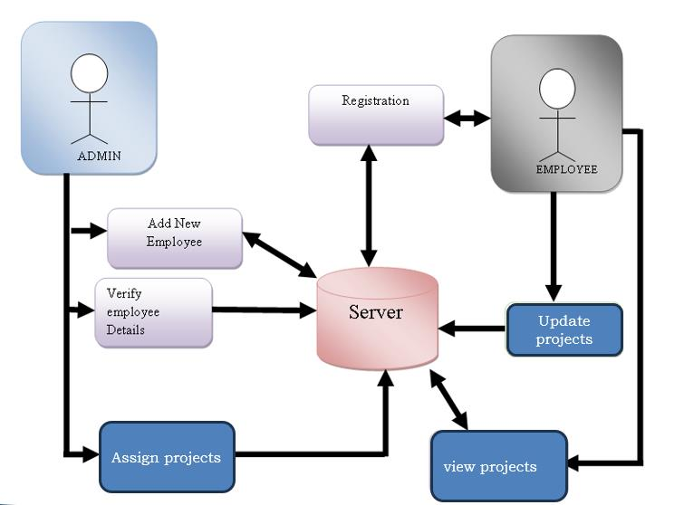
System Design & Implementation
The design procedure for the time tracking and productivity analysis web application involves a systematic and iterative process, encompassing various stages from conceptualization to implementation.
Architechture diagram:-
An architectural diagram is a visual representation that maps out the physical implementation for components of a software system. It shows the general structure of the software system and the associations, limitations, and boundaries between each element.

Slide 16
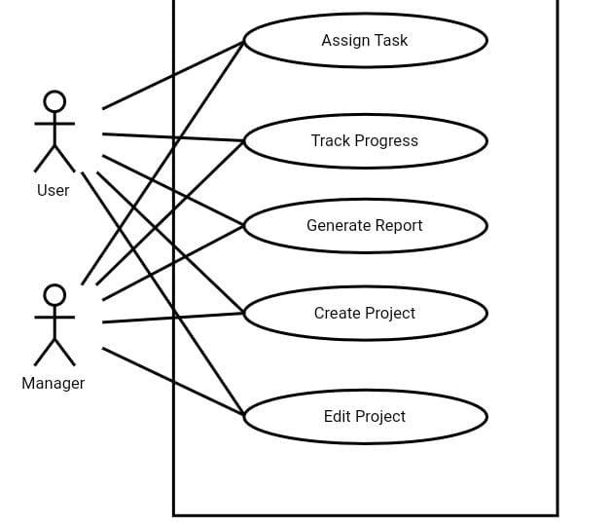
System Design & Implementation
Use case diagram:-
A use case diagram is a graphical depiction of a user's possible interactions with a system. A use case diagram shows various use cases and different types of users the system has and will often be accompanied by other types of diagrams as well. The use cases are represented by either circles or ellipses.

Slide 17
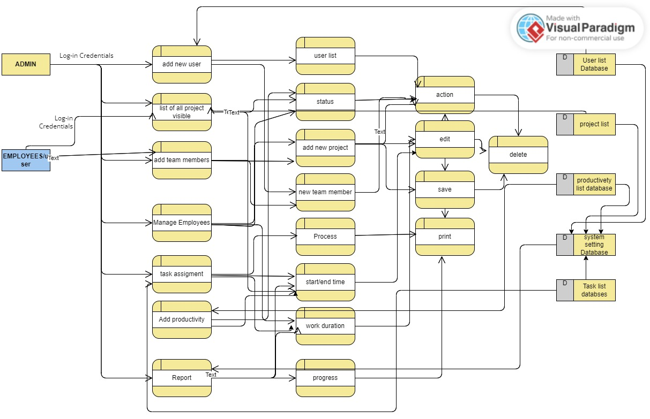
System Design & Implementation
Data flow diagram:-
A data flow diagram (DFD) maps out the flow of information for any process or system. It uses defined symbols like rectangles, circles and arrows, plus short text labels, to show data inputs, outputs, storage points and the routes between each destination.

Slide 18
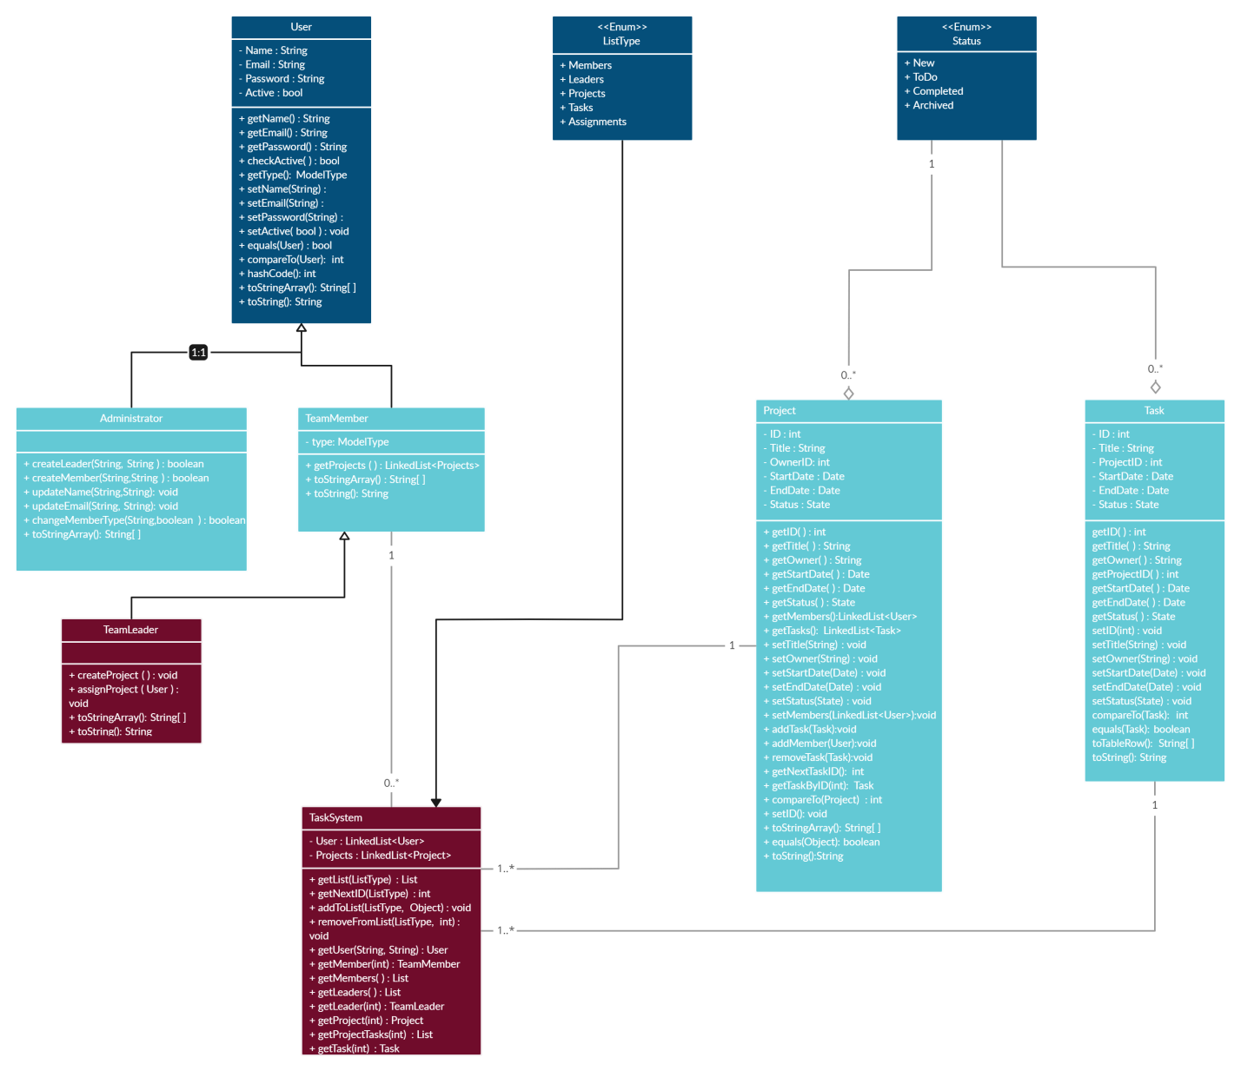
System Design & Implementation
CLASS DIAGRAM:-
A class diagram is one type of UML diagram that represents the static view of a software system. A class diagram is used to visualize, describe, and document various aspects of a system, and also to create executable software code. It illustrates the types of objects present in a system and the different types of relationships that exist between them.
Task management class diagram:-

Slide 19
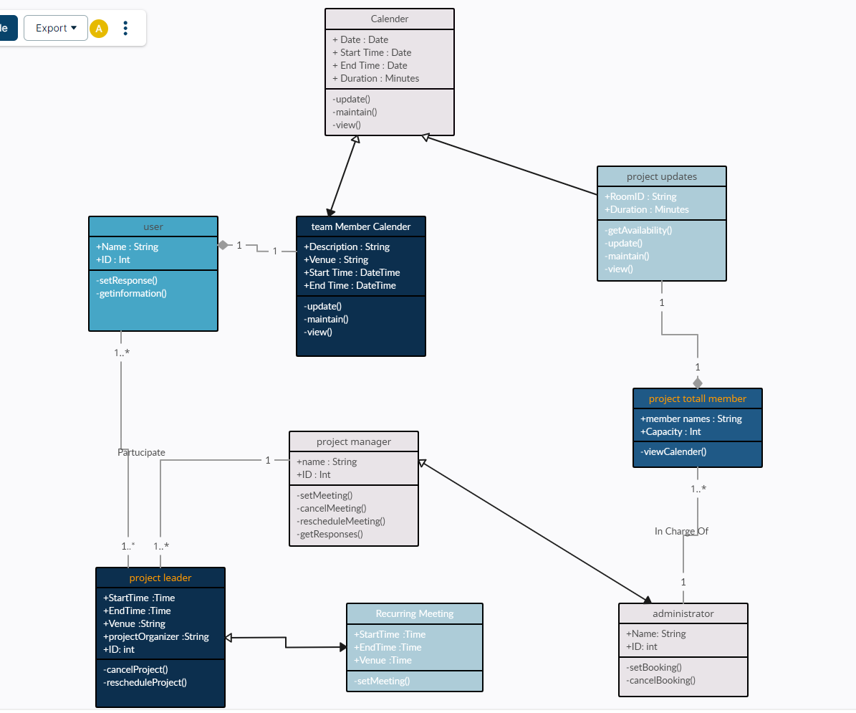
System Design & Implementation
Time management class diagram:-

Slide 20
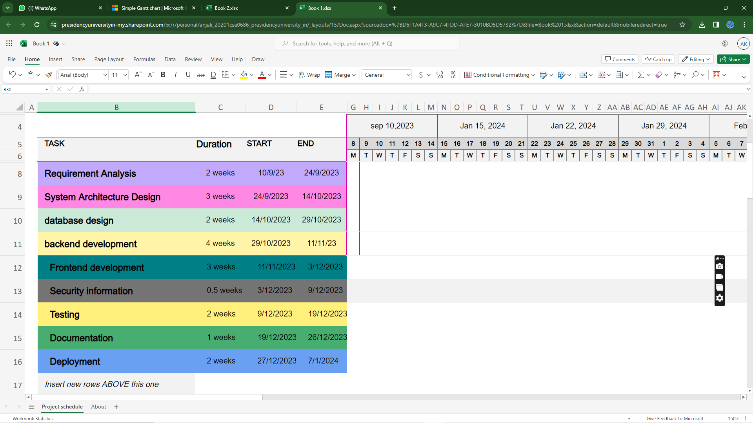
Timeline of Project
GANTT CHART

Slide 21
Outcomes / Results Obtained
1. Identification of Time Wasters.
2. Efficiency Improvements.
3. Time Allocation Insights.
4. Productivity Metrics.
5. Cost Savings or reallocating resources.
6. Improved Work-Life Balance .

Slide 22
Conclusion
We propose a “SPARK” (Strategic Productivity Analytics and Reporting Kit) for applications that necessitate gathering productivity data from remote sites for a given business entity. SPARK is aimed at reducing on productivity data entry and analysis workload from a central input point. Other beneits that we expect to realize from the tool include reduction of data loss and time taken entering productivity data. The tool is generally aimed for utilization by any given organization in a ‘developing area’, but relies on availability of the Internet in any form.
We report on the current status in the development of the tool and discuss its software implementation prospects. For the purpose of discussing different aspects concerning the tool, we use banks as a case study. We avail general implementation requirements for the tool which we expect should lead to a variety of options for implemention.

Slide 23
Conclusion
In summary, the incorporation of time and productivity analysis emerges as a foundational element for organizational triumph. Through the adept deployment of analysis methodologies, organizations can not only boost efficiency but also strategically optimize resource allocation, thereby fostering a comprehensive enhancement of overall performance.
Crucial takeaways from this presentation highlight the importance of embracing decision-making rooted in data, recognizing the pivotal role of technology in shaping the future of analytical processes, and providing actionable recommendations for organizations to elevate their productivity. Armed with these insights, organizations are well-positioned to unlock their full potential, align strategies with data-driven perspectives, and effectively navigate toward the achievement of their goals.

Slide 24
References
BERGER, I.R., DORI, D., KATZ, S. 2002. OPM/Web – Object-Process Methodology for Developing Web
Applications. Annals of Software Engineering 13(1-4), 141-161.
CHASSIAKOS, A.P. AND SAKELLAROPOULOS, S.P. 2008. A Web-based System for Managing Construction
Information. In Advances in Engineering Software, 39(11):865-876.
CHOE, J. and YOO, S. 2008. Web-based Secure Access from Multiple Patient Repositories. In International
Journal of Medical Informatics, 77 (4): 242-248.
CONALLEN, J. 2000. Building Web Applications with UML. Addison Wesley, Boston, MA.
GELLERSEN, H-W. AND GAEDKE, M. (1999). Object-oriented Web Application Development. IEEE Internet
Computing, 3(1): 60-68, IEEE Educational Activities Department.
HOWCROFT, D., AND CARROLL, J. 2000. A Proposed Methodology for Web Development. In Proceedings of
the European Conference on Information Systems, Vienna, 290-297.
IÑESTA, L., AQUINO, N., AND SÁNCHEZ, J. (2009). Framework and authoring tool for an extension of the
UML Language. In Advances in Engineering Software, 40(2009): 1287-1296.
LAWLOR, A. (1985). Productivity Improvement Manual. Westerport, CT: Quorum Books.
LEE, S.C. 1998. IDM: A Methodology for Intranet Design. In Proceedings of the International Conference on

Slide 25
References
Information Systems, Helsinki, Finland. Association for Information Systems, 51-67.
MURDICK, R.G., RENDER, B., AND RUSSEL, R.S. (1990). Service Operations Management. Boston,
Massachusetts: Allyn and Bacon.
RAO, M.P., MILLER, D.M., AND LIN, B. 2002. PET: An Expert System for Productivity Analysis. Expert Systems
with Applications 29, 300-309.
ROCKVILLE, MD: FDA, 2002 “General Principles of Software Validation: Final Guidance for Industry and
FDA Staff”
SCHWABE, D. AND ROSSI, G. 1998. An Object Oriented Approach to Web-Based Application Design. Draft
copy, unpublished.

Slide 26
Publication Details

Slide 27
Achievements (if any)

Slide 28

Thank You

